Slide 1

ME224 - Microscale Flows
Studying Diffusion and Fluid flow for gradient Formation in microfluidic platforms
Department of Mechanical Engineering
Indian Institute of Technology Indore
Course Coordinator :
Dr. Vijai Laxmi
Assistant Professor
Department of Mechanical Engineering
Presented by :
Group Members
Sumit Sarkar(230003075)
Sri Varsha Dodda(230003074)
Shreeyut Maheshwari(230003071)

Slide 2
Content
Introduction
Literature review
Motivation and Objective
Methodology
Results and discussions
Conclusion
Future scope
References

Slide 3
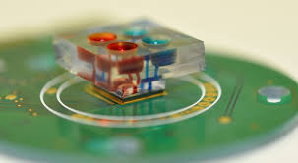
Introduction
Microfluidic systems are widely used for precise fluid control in biomedical, chemical, and analytical applications. This project focuses on designing a serpentine microfluidic mixer to create a controlled gradient by mixing two inlet streams: red and blue resulting in a purple gradient transition.
Fig. 1 Bioengineering Application
The design was simulated in ANSYS Fluent to analyze fluid flow and diffusion. It was then fabricated using PDMS and a curing agent, molded, and baked. This study optimizes gradient formation for lab-on-a-chip and chemical mixing applications.
Reference of image: Link

Slide 4
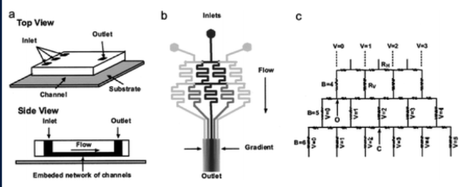
Literature Review
Our Project was mainly based on two Research Papers:
Paper 1^{[1]}: This study presents a microfluidic system that generates precise gradients through controlled mixing of laminar flows. It achieves this by splitting, mixing, and recombining streams, allowing for both static (fixed) and dynamic (adjustable) gradient profiles based on flow rate variations.
Literature Review
Fig. 1^{[1]} (a) Scheme of the PDMS microfluidic gradient generator used in this work. (b) Schematic design of a representative gradient-generating microfluidic network.(c) Equivalent electronic circuit model of the pyramidal microfluidic network.

Slide 5
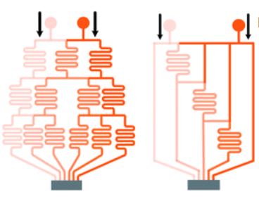
Literature Review
Our Project was mainly based on two Research Papers:
Paper 2^{[2]}: Various gradient generators in microfluidics were analyzed, highlighting their pros and cons.
Tree-shaped networks create gradients by branching and recombining streams, while altered tree networks address limitations of traditional designs.
Literature Review
Fig2^{[2]}.Altered Tree Shape Diagram
Y-junctions rely on diffusion, membrane systems use porous barriers, and pressure balance systems prevent convection by equalizing inlet and outlet pressures.

Slide 6
Motivation and objectives
Motivation
Microfluidic systems are essential in biomedical and chemical research, enabling precise fluid control for applications like drug screening, tissue engineering, and chemical analysis. Efficient gradient formation is critical for these processes, requiring a deep understanding of diffusion and fluid flow dynamics in microchannels. This project aims to enhance microfluidic design for optimized gradient generation, contributing to advancements in lab-on-a-chip technology and controlled chemical mixing.
Objective
To study diffusion and fluid flow dynamics for gradient formation in microfluidic platforms by designing a serpentine mixer, simulating fluid behavior in ANSYS Fluent, and fabricating the device using PDMS.

Slide 7
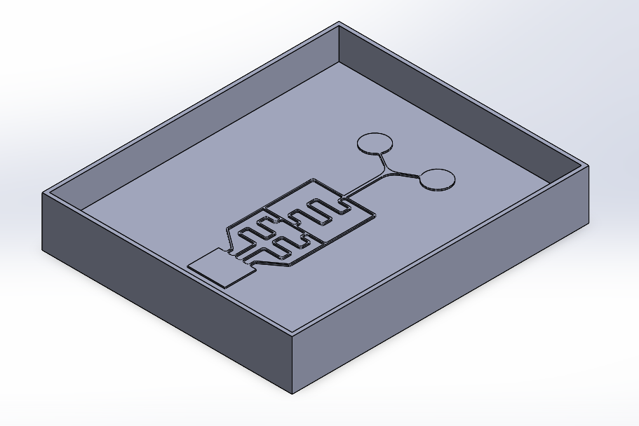
Methodology
Research Phase
We reviewed papers on gradient formation to understand diffusion dynamics and microfluidic mixing strategies
Cad Modelling
The microfluidic mixer features three serpentine channels with two inlets for red and blue fluids. A single outlet allows observation of the resulting purple gradient formation.
Total Length : 31.75 mm
40 mm by 47 mm Mold

Slide 8
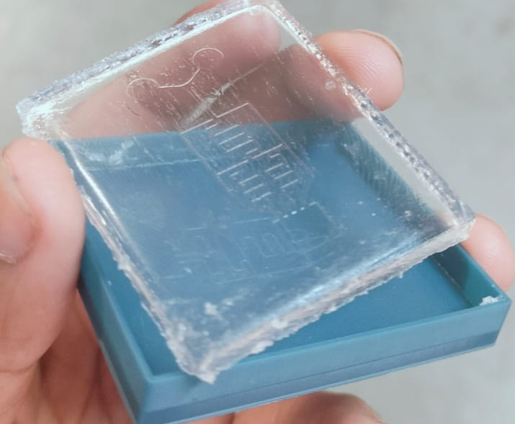
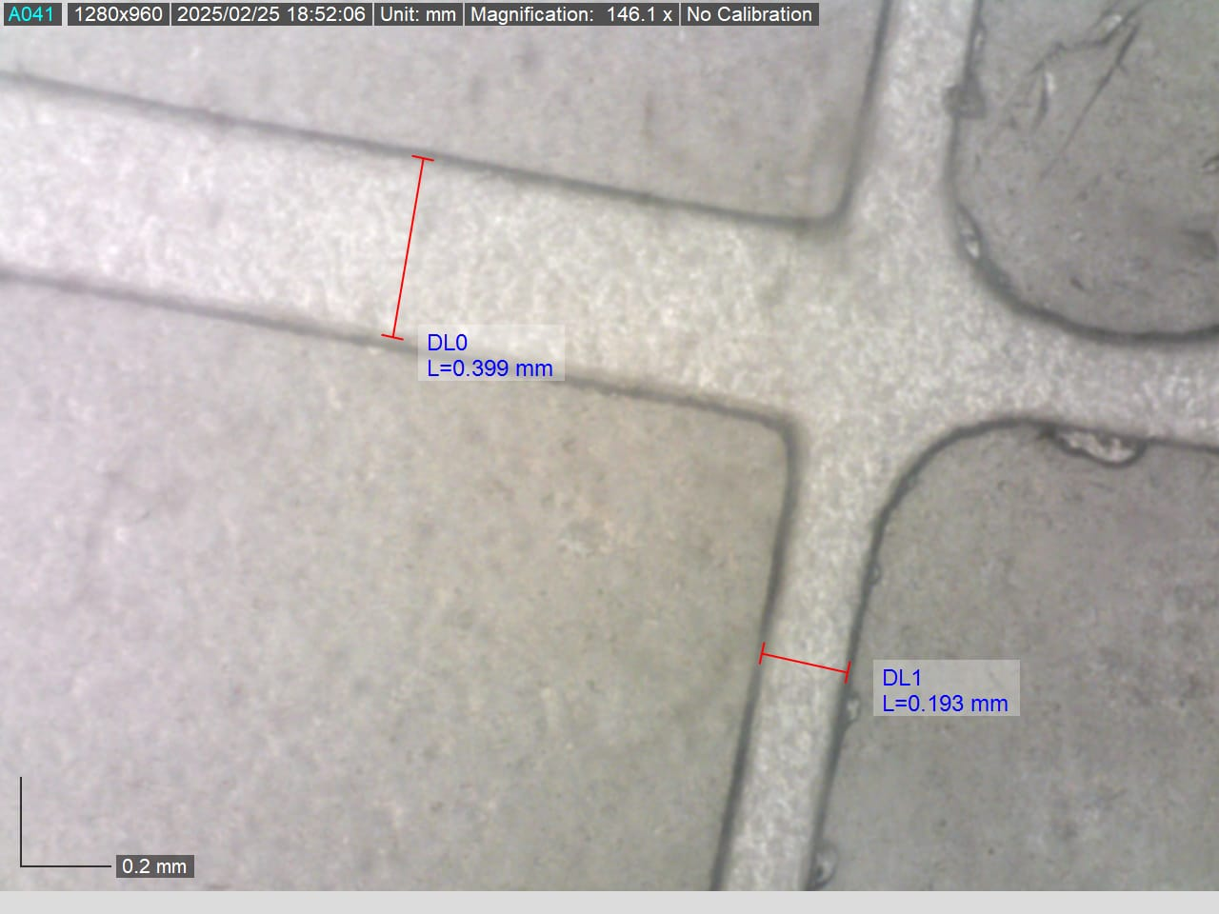
Methodology
Simulation
Simlulated on Ansys Fluent 2024 R1
We used the Eulerian mixture model for laminar flow (Re<1). Continuity , Momentum equations solved and Species Transport to apply Fick’s law of diffusion.
Boundary Conditions
Inlet Velocity
Gauge Pressure = 0 along with no shear
Fabrication
Soft Lithography
The resin mold was fabricated, cleaned, and cured. PDMS was poured, baked, peeled off, and bonded to a glass plate.

Slide 9
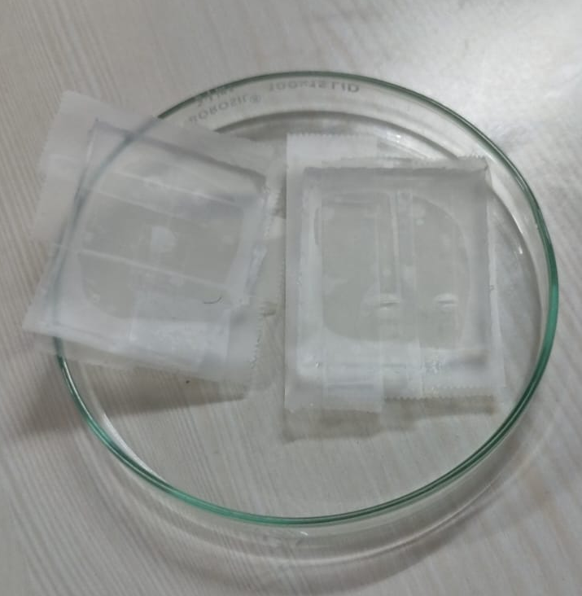
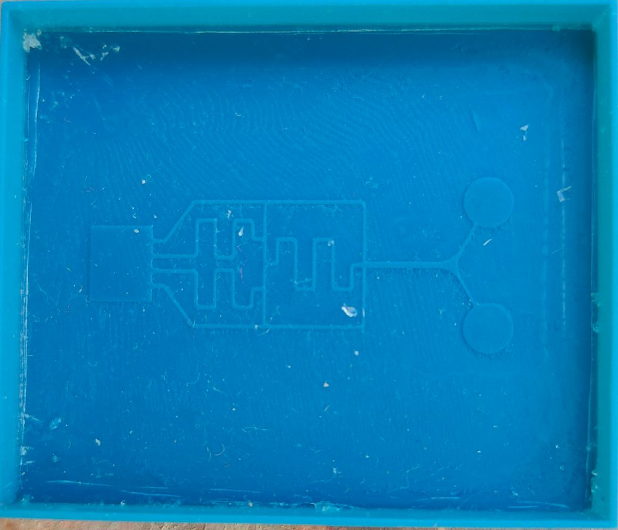
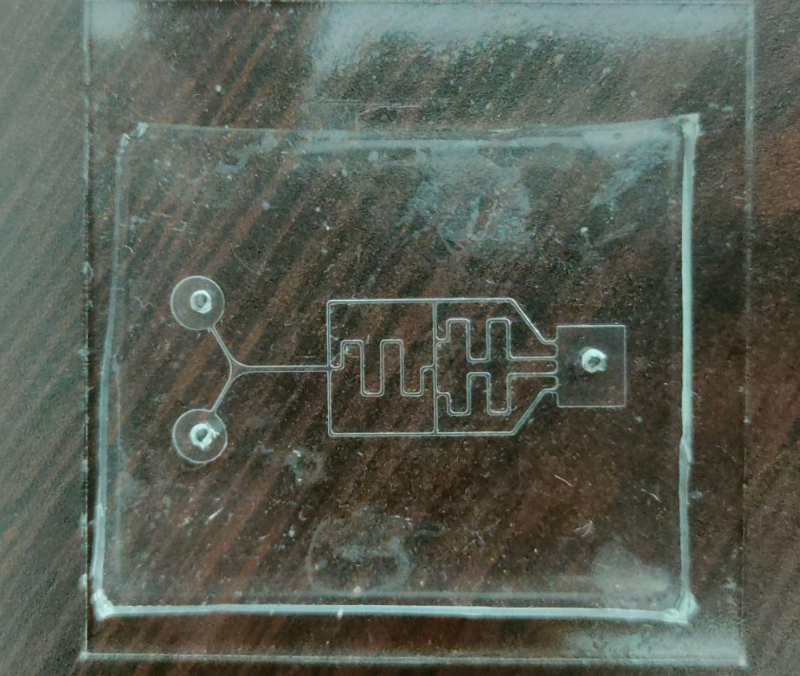
Methodology
Experimenting
Preparation of Dyes: Two separate dye solutions, red and blue, were prepared.
Injection into Inlets: The dyes were carefully poured into their respective microfluidic inlets.A volume flow rate of 0.2ml/min was set.
Gradient Formation: As the fluids traveled through the serpentine channels, controlled mixing occurred.

Slide 10
Results and discussion
Calculation :
Hydraulic Diameter Dh: where A = Cross Section and P is wetted perimeter
Dh = 4A/P = 204.87 microns
Reynolds Number:
Re = ρvDh/μ = 0.02
Peclet Number:
Pe = Dhv/D = 205
For water, the diffusivity D is 10^−10 m2/s.
Since Pe > 1, advection is stronger than diffusion, but not significantly

Slide 11
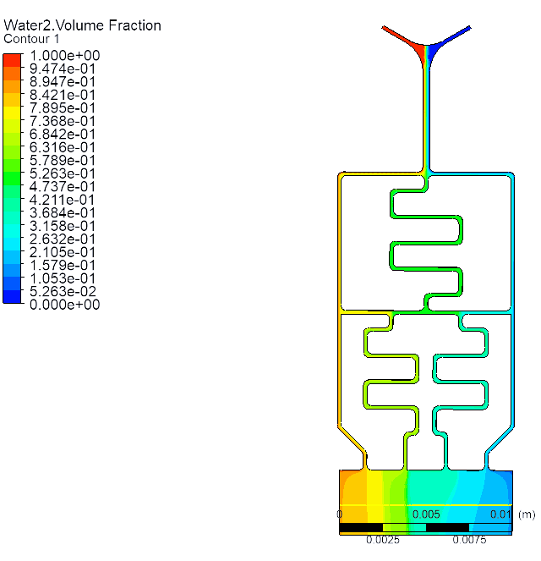
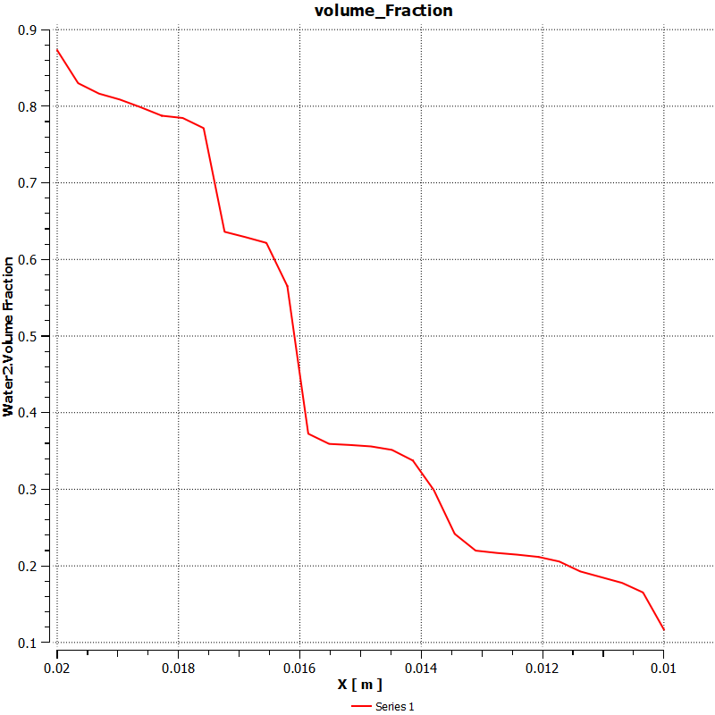
Results and discussion
Base Case (Both the inlets have velocity of 1e-4 m/s).
In the graph we can see that the volume fraction of water with red dye is decreasing.
Overall a uniform Gradient is obtained ,which ensures the mixing is proper and uniform inside the serpentine channels.
Fig.2 Volume_Fraction (Graph)
at the outlet
Fig.1 Volume fraction contour plot of Fluid water with red coloured dye

Slide 12
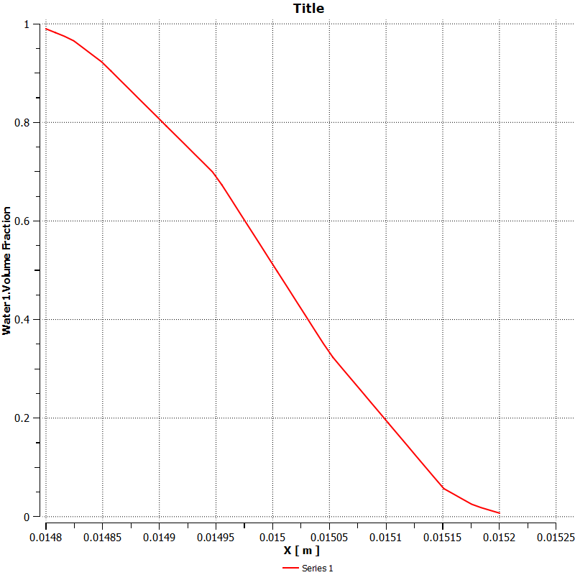
Results and discussion
The volume fraction at neck shows proper diffusion in the beginning of the microfluidic device.
Also considered steady so by ficks law gradient of concentration should be constant .
dC/dt=D*d2C/dx2 where dc/dt =0
C = ax+b
which means it varies linearly with distance
Anomalous Diffusion - as the concentration gradient is not perfectly linear and has some deviations with x.
Fig 3 Volume_Fraction (Graph)
at the Y-Bifurcation

Slide 13
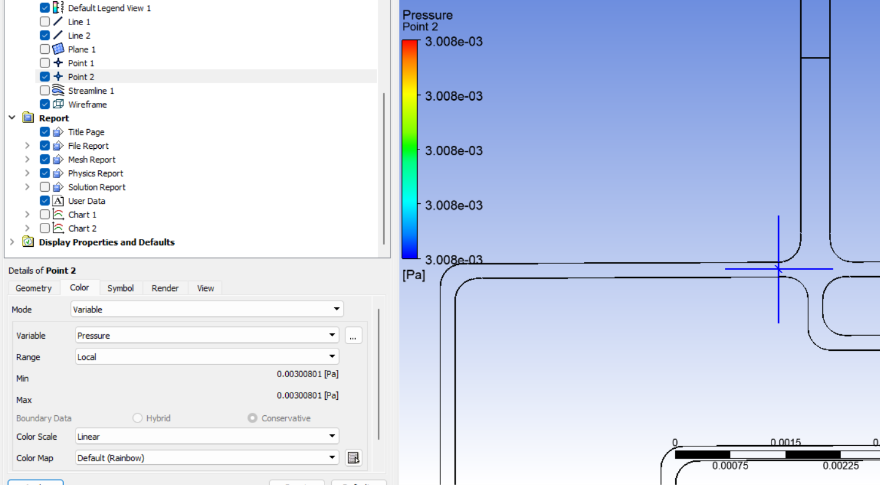
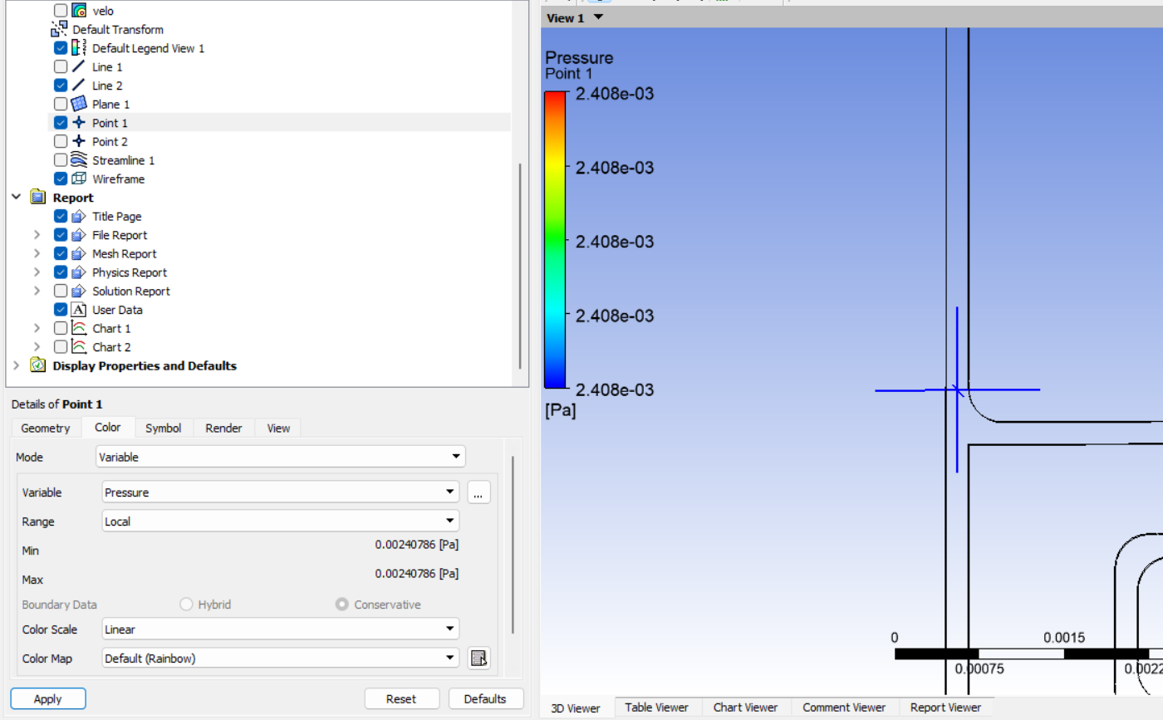
Results and discussion
The numerical pressure difference was calculated as 0.673 Pa with a velocity of 6.95 × 10⁻⁵ m/s in the branch.
The numerical flow rate(Q) was determined to be 2.919 × 10⁻¹² m³/s.
The numerical hydraulic resistance was 2.09 × 10⁸ Pa·s/m³, while the analytical value was
(28 mu L/h^4)
Rh = 28*10^-3*12.22*10^-3/(204*10^-6)^4
Rh = 1.97 × 10⁸ Pa·s/m³
The error between numerical and analytical solutions was (2.09-1.97/1.97)*100 = 6.09%

Slide 14
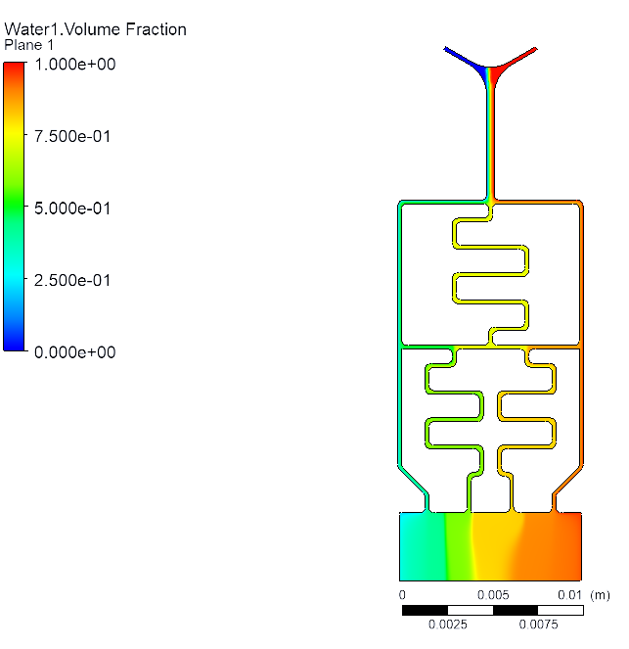
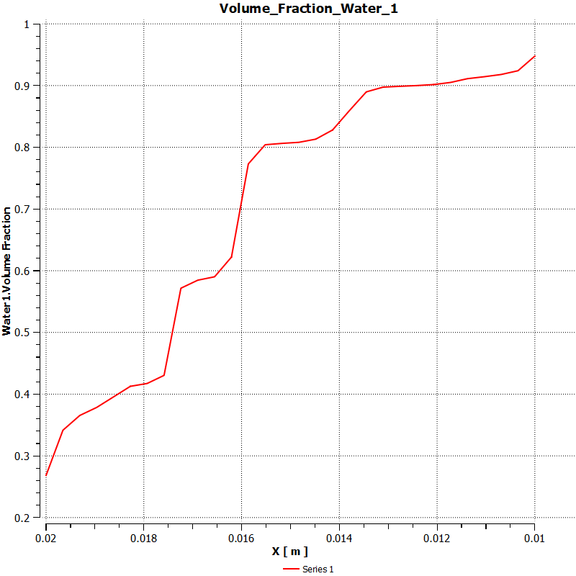
Results and discussion
Velocity Ratio= 1:2 Case (Inlets have velocity of 5e-5 m/s and 1e-4 m/s respectively )
In the graph we can see that the volume fraction of water with red dye is decreasing more gradually.
A uniform gradient was observed for the red dye due to its higher velocity. This indicates that achieving a low-slope gradient requires increasing the flow rate of the respective fluid.
Fig.5 Volume_Fraction (Graph)
at the outlet
Fig.4 volume fraction contour plot of Fluid water with red coloured dye(Velocity 1:2)

Slide 15
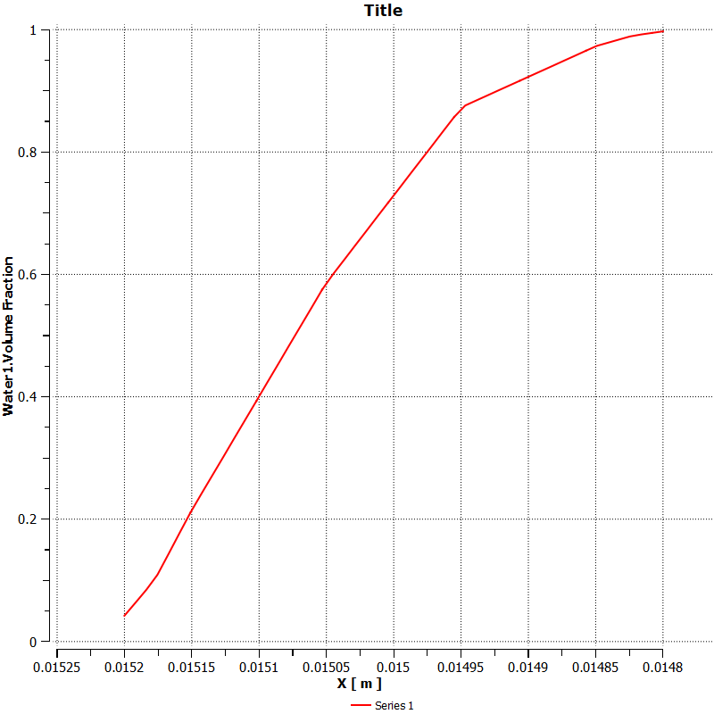
Results and discussion
This curve represents the volume fraction of water 1 (Red dye) with distance at the Y bifurcation.
It's not linear again shows that our case is anomalous diffusion
Fig.6 Volume_Fraction (Graph)
at the Y-Bifurcation

Slide 16
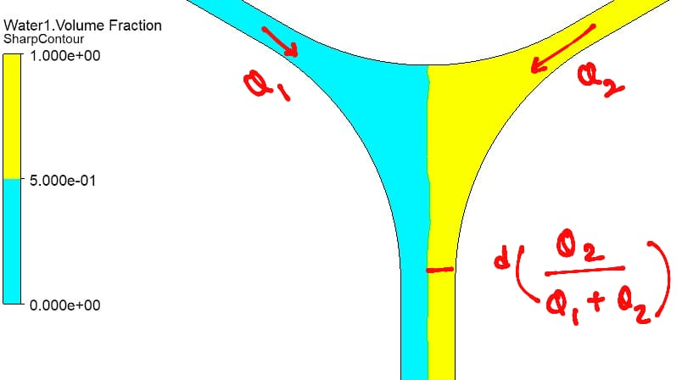
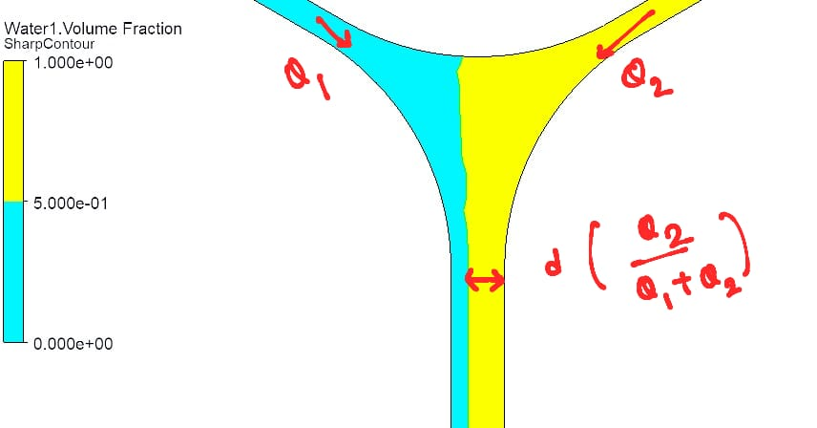
Results and discussion
The distance of interface and wall is given by d(Q2/(Q1+Q2)).
In the Base Case, velocity Ratio is 1:1.
Q2=Q1
Thickness = d/2 where d= 400 microns
Thickness = 200 microns
In the Second Case, velocity Ratio is 1:2.
Q2=4Q1
Thickness=4d/5 where d= 400 microns
Thickness = 320 microns

Slide 17
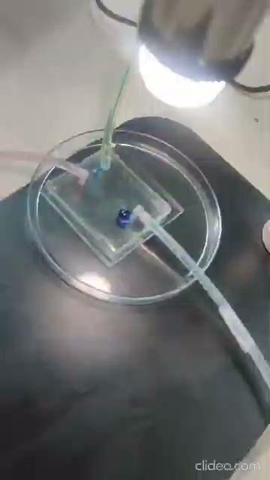
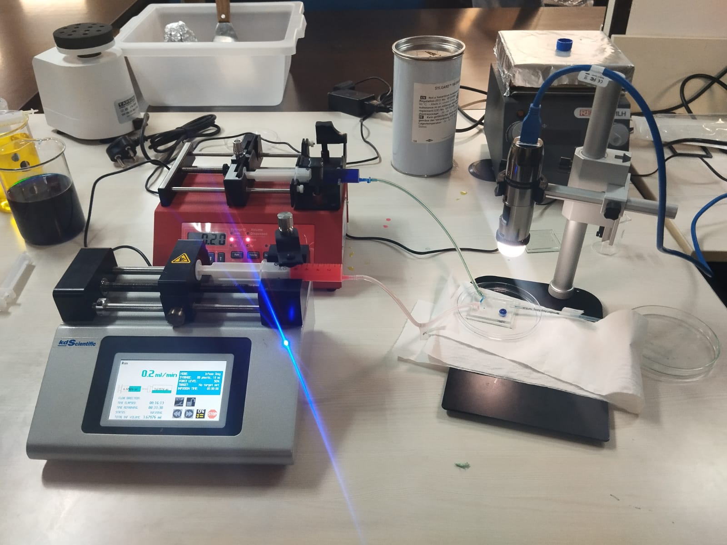
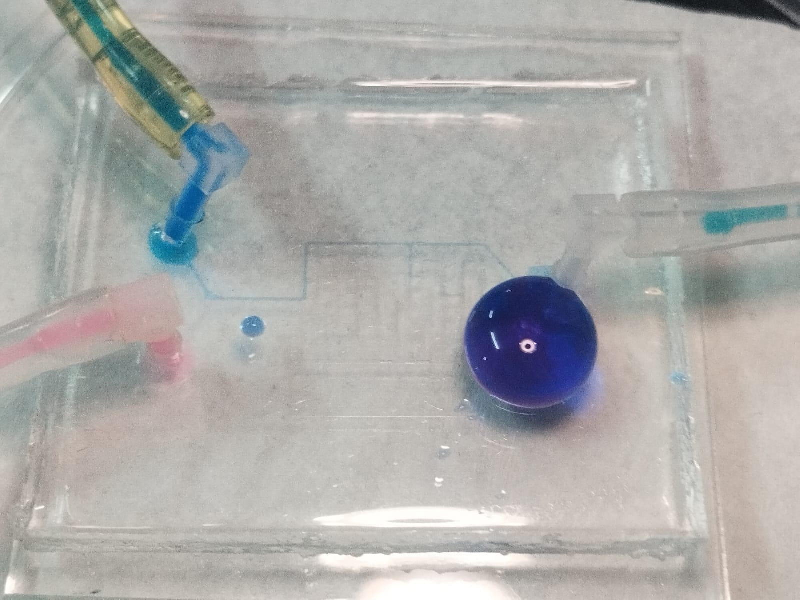
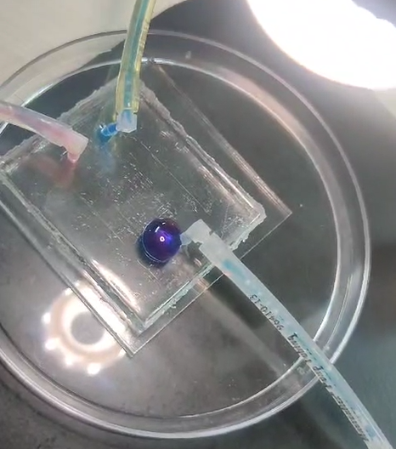
Results and discussion
Experimental Results:

Slide 18
Conclusions
A uniform gradient was achieved, ensuring proper mixing in the serpentine channels.
Anomalous diffusion was observed, as the concentration gradient resembles with the concentration profile of anomalous diffusion.
Higher flow rates resulted in a lower-slope gradient, confirming the impact of velocity on gradient formation.
The numerical hydraulic resistance closely matched the analytical value, with a 6.09% error.
The study emphasizes the role of flow control in optimizing microfluidic mixing for biomedical and chemical applications

Slide 19
Future scope
This research can be further developed in several ways to enhance the design, simulation accuracy, and practical applications of the microfluidic mixer:
Multiphysics Simulations – Incorporating factors like fluid viscosity variations, electrokinetic effects, and heat transfer in simulations could provide a more comprehensive understanding of mixing behavior.
Parametric Optimization – Conducting extensive simulations to analyze the effects of flow rate variations, Reynolds number, and channel width on mixing efficiency can lead to an optimized design.
Scalability and Miniaturization – Developing designs for compact, high-throughput microfluidic devices can facilitate integration into lab-on-a-chip platforms.

Slide 20
References
[1]. Israelachvili, J. (2000) 'Generation of solution and surface gradients using microfluidic systems', Langmuir, 16(5), pp. 1891–1895.
[2]. Wang, X., Liu, Z. and Pang, Y. (2017) 'Concentration gradient generation methods based on microfluidic systems', RSC Advances, 7(44), pp. 27711–27745.

